Slide 1
Computer Programming Basics
Jeon, Seokhee
Assistant Professor
Department of Computer Engineering,
Kyung Hee University, Korea

Slide 2
CHAPTER 9
Pointers – Part 2

Slide 3
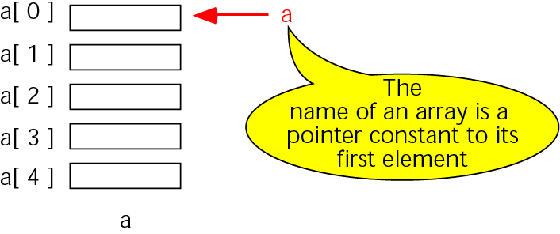
Pointers to arrays
same
a &a[0]
‘a’ is a pointer only to the first element, not the whole array

Slide 4
Array name as a pointer
int main ()
{
int a[3];
cout << &a[0];
// → 1004
cout << a;
// → 1004
}
a[0]
a[1]
a[2]
1000
2000
3000
1004
1008
1012
1016
The name of an array is a pointer constant to its first element
a

Slide 5
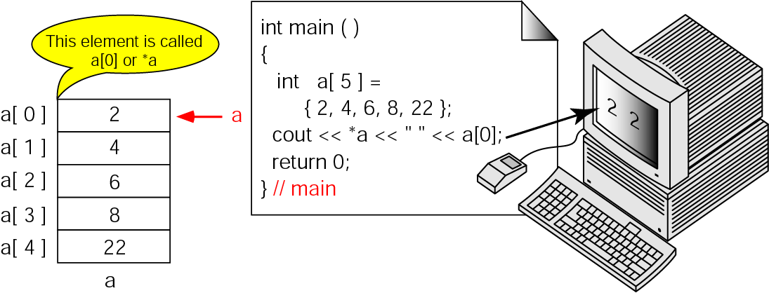
Dereference of array name

Slide 6
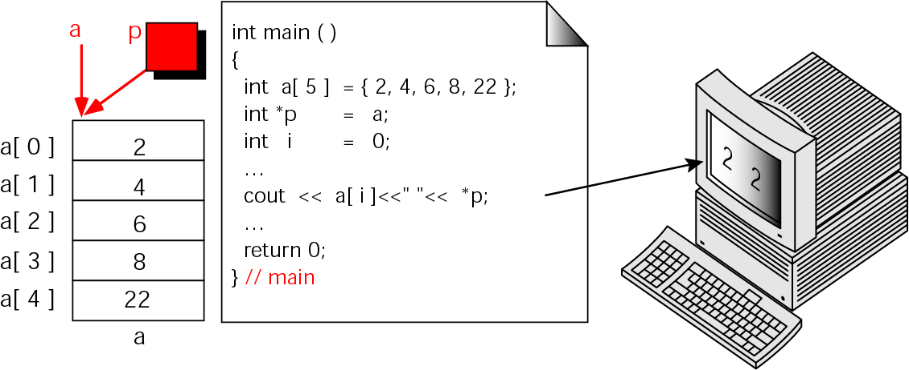
Array names as pointers

Slide 7
Note:
To access an array, any pointer to the first element can be used instead of the name of the array.

Slide 8
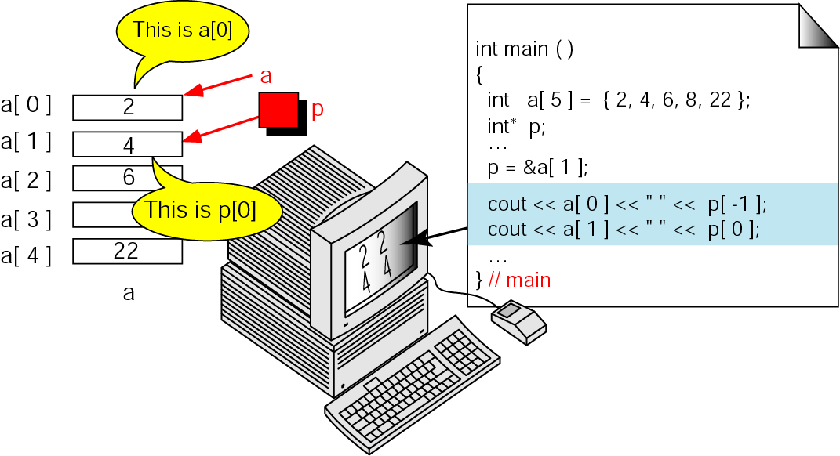
Multiple array pointers

Slide 9
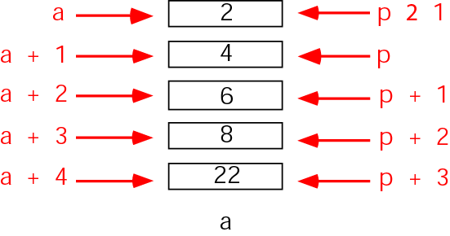
Pointer Arithmetic and Arrays
Given pointer, p, p ± n is a pointer to the value n elements away.

Slide 10
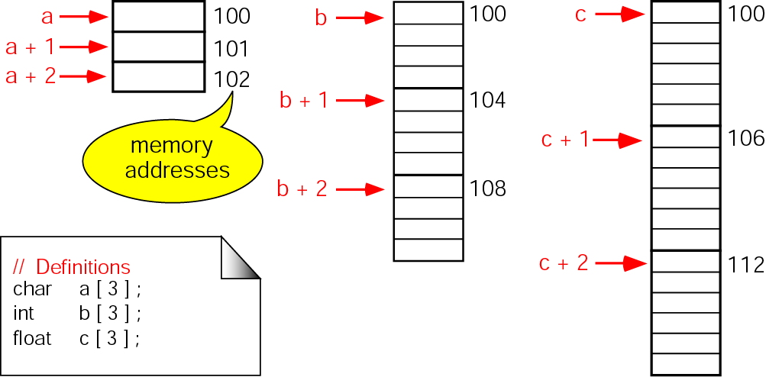
Pointer arithmetic and different types

Slide 11
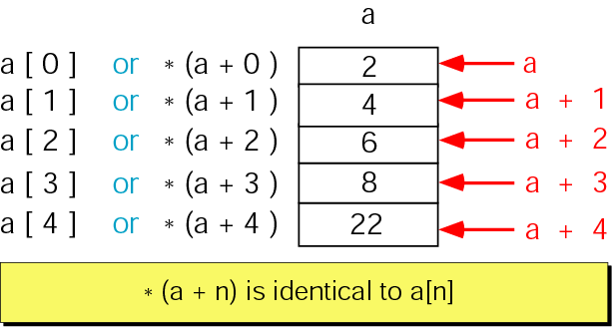
Dereferencing array pointers

Slide 12
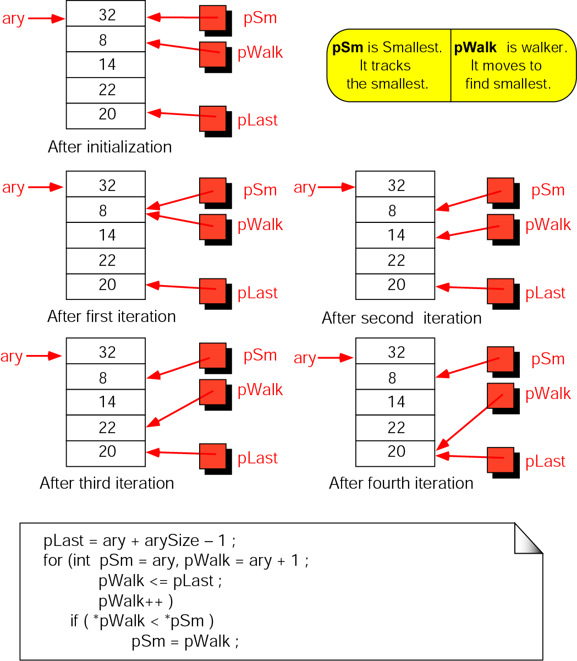
Find smallest

Slide 13
Pointers and other operators
int a[20];
int * p = &(a[5]);
for(int i=0;i<20;i++)
a[i] = i;
cout << p+5 << endl; //address of a[10]
cout << *(p+5) << endl; //10
cout << *(p++) << endl; //5
cout << *(--p) << endl; //5
int * q = &(a[10]);
cout << *(p + (q-p)/2) << endl; //7
return 0;

Slide 14
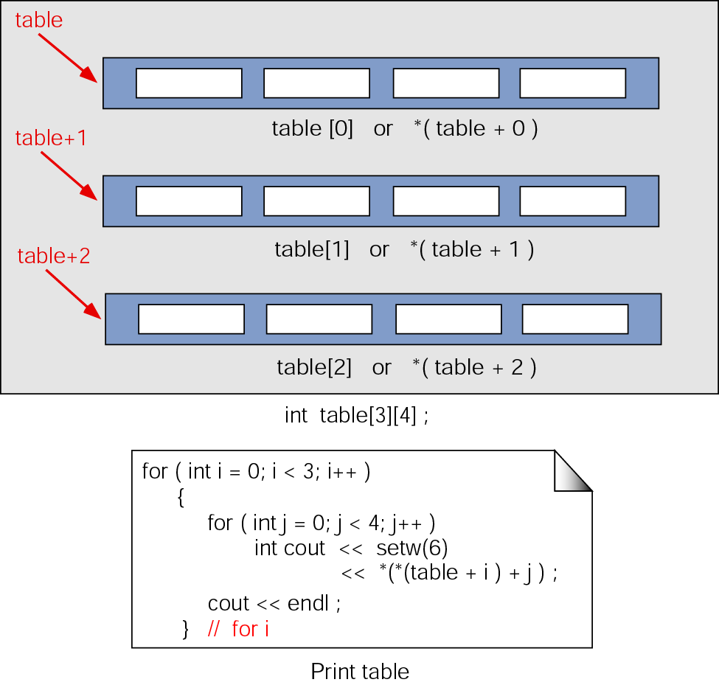
Pointers to two-dimensional arrays

Slide 15
Pointers to two-dimensional arrays
table[0] is identical to *(table + 0)
table[0][0] is identical to *(*(table)
table[i][j] is identical to *(*(table + i) + j)

Slide 16
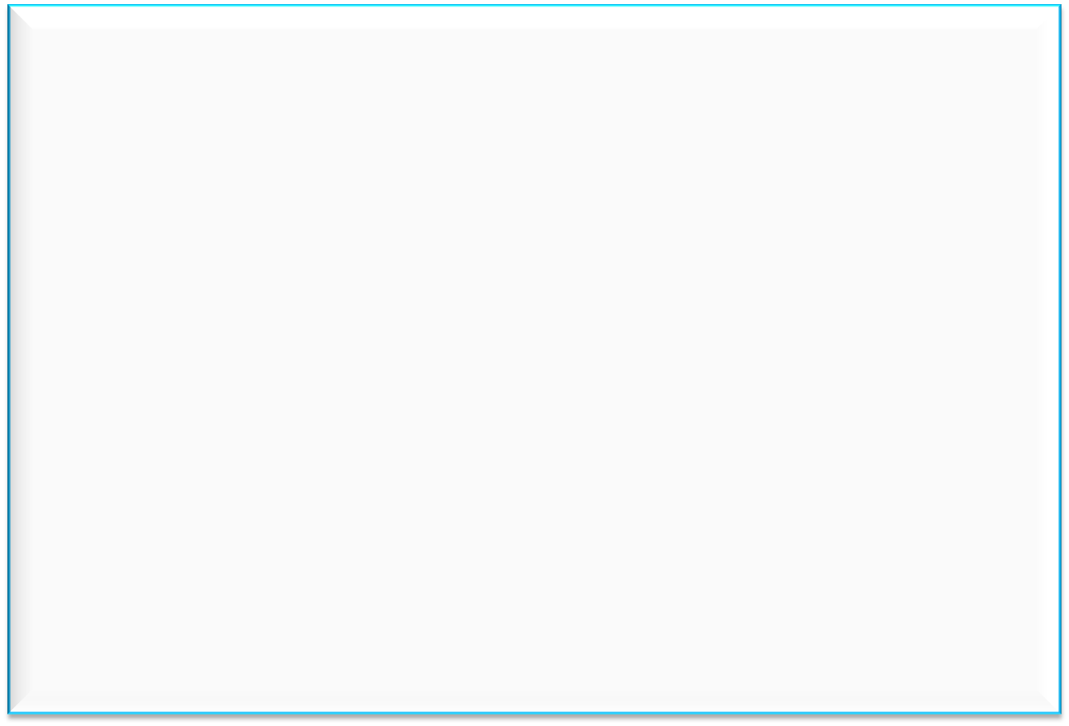
Two dimension array and pointer
int Dim2[3][4]
0013FF10
0013FF14
0013FF18
0013FF1C
1
2
3
4
0013FF20
0013FF24
0013FF28
0013FF2C
5
6
7
8
0013FF30
0013FF34
0013FF38
0013FF3C
9
10
11
12

Slide 17
Two dimension array and pointer
int Dim2[3][4]
0013FF10
0013FF14
0013FF18
0013FF1C
Dim2[0][0]
Dim2[0][1]
Dim2[0][2]
Dim2[0][3]
Dim2[0]
1
2
3
4
0013FF20
0013FF24
0013FF28
0013FF2C
Dim2[1][0]
Dim2[1][1]
Dim2[1][2]
Dim2[1][3]
Dim2[1]
5
6
7
8
0013FF30
0013FF34
0013FF38
0013FF3C
Dim2[2][0]
Dim2[2][1]
Dim2[2][2]
Dim2[2][3]
Dim2[2]
9
10
11
12

Slide 18
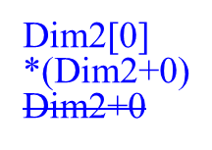
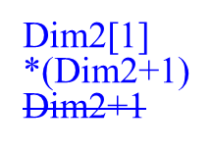
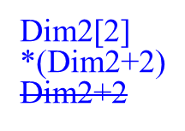
Two dimension array and pointer
int Dim2[3][4]
It’s a “Pointer to Pointer”
Dim2
Points to
start of array
0013FF10
0013FF14
0013FF18
0013FF1C
1
2
3
4
0013FF20
0013FF24
0013FF28
0013FF2C
5
6
7
8
0013FF30
0013FF34
0013FF38
0013FF3C
9
10
11
12

Slide 19
Two dimension array and pointer
int Dim2[3][4]
*(Dim2[1]+1)
*(*(Dim2+1)+1)
0013FF10
0013FF14
0013FF18
0013FF1C
1
2
3
4
Dim2[1]+1
*(Dim2+1)+1
0013FF20
0013FF24
0013FF28
0013FF2C
5
6
7
8
0013FF30
0013FF34
0013FF38
0013FF3C
9
10
11
12

Slide 20
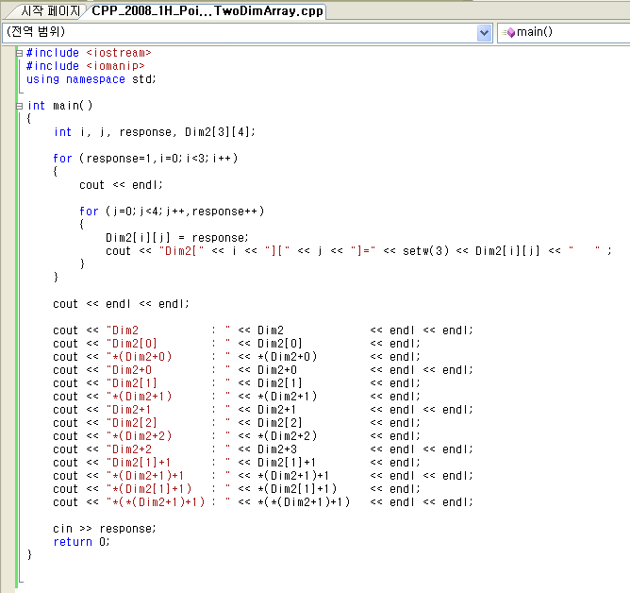
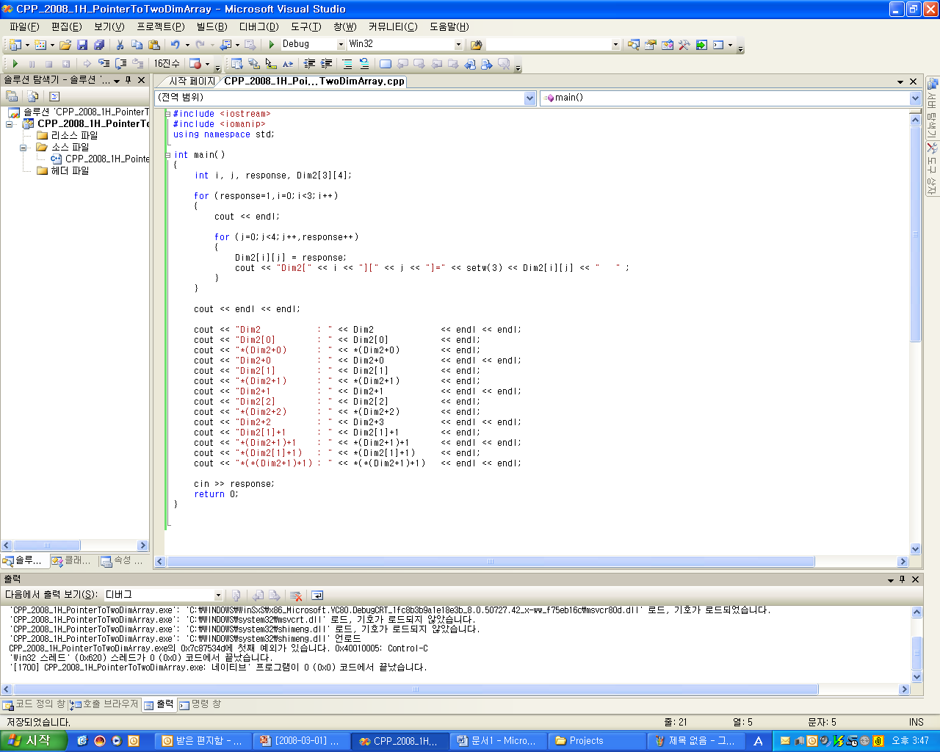
Simple codes

Slide 21
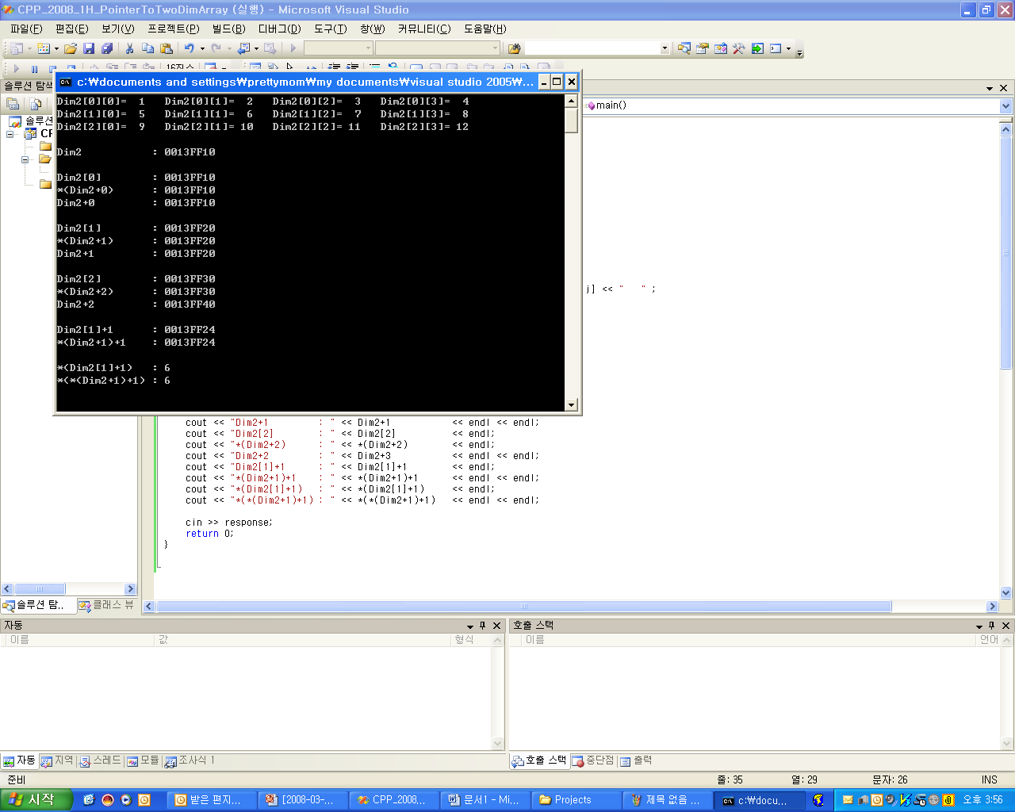
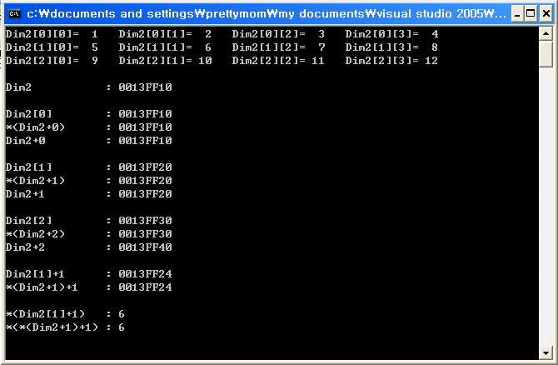
Results

Slide 22
Passing one dimensional array to a function
void doIt(int ary[]);
void doThat(int *ary);
int main()
{
int a[10];
int *p = &(a[0]);
doIt(a);
doThat(a);
doIt(p);
doThat(p);
doIt(&(a[0]));
doThat(&(a[0]));
}

Slide 23
Passing 2 dimensional array to a function
void doIt(int ary[][20]);
void doThat(int **ary); //wrong
int main()
{
int a[10][20];
int (*p)[20] = a;
doIt(a);
doThat(a); //wrong
doIt(p);
doThat(p); //wrong
doIt(&(a[0]));
doThat(&(a[0])); //wrong
}

Slide 24
Passing 3 dimensional array to a function
void doIt(int ary[][10][20]);
int main()
{
int a[5][10][20];
int (*p)[10][20] = a;
doIt(a);
doIt(p);
doIt(&(a[0]));
}

Slide 25
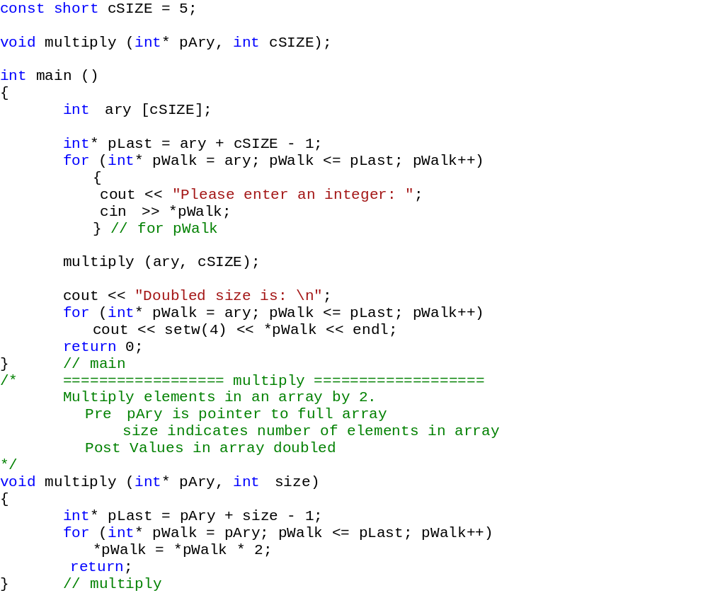
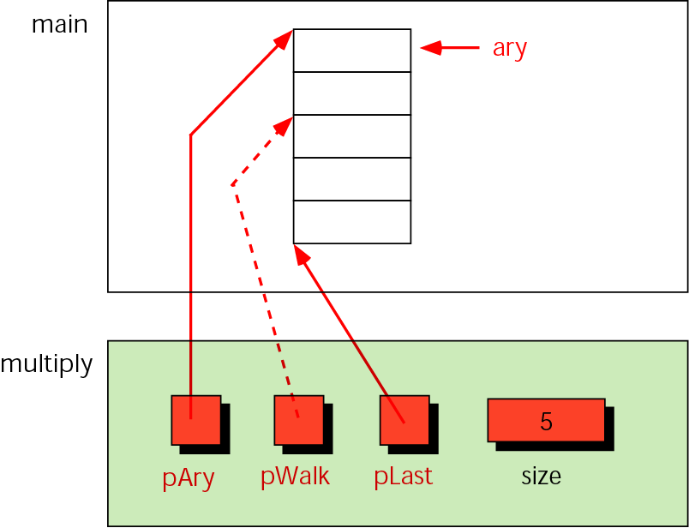
Example: variables for multiplying array elements
Results:
Please enter an integer: 2
Please enter an integer: 7
Please enter an integer: 12
Please enter an integer: 3
Please enter an integer: 6
Doubled size is:
4
14
24
6
12

Slide 26
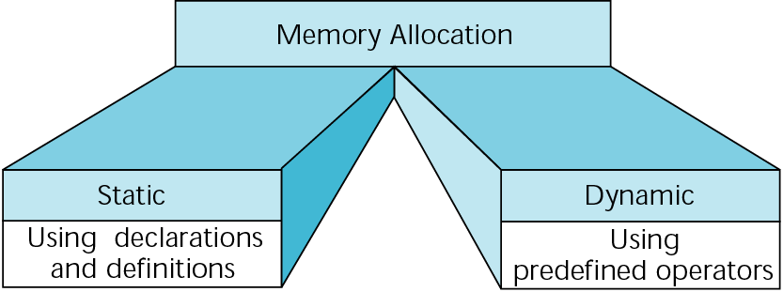
Memory allocation

Slide 27
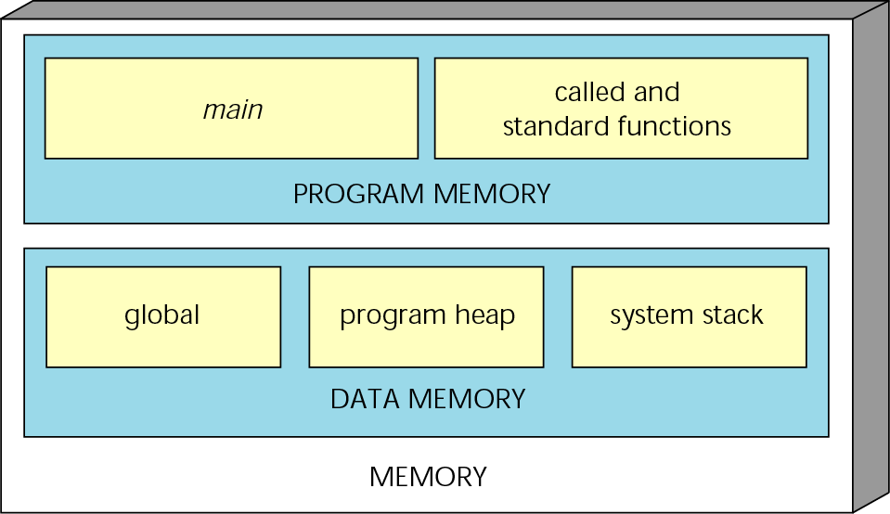
A conceptual view of memory

Slide 28

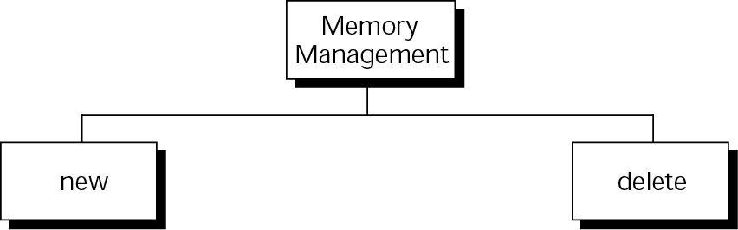
Memory management functions

Slide 29
Note:
You can refer to dynamic memory only through a pointer.

Slide 30
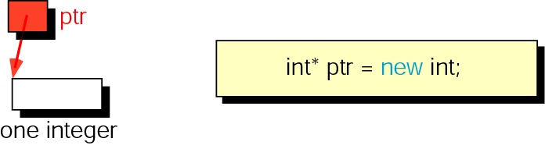
new memory allocation for a single data item

Slide 31
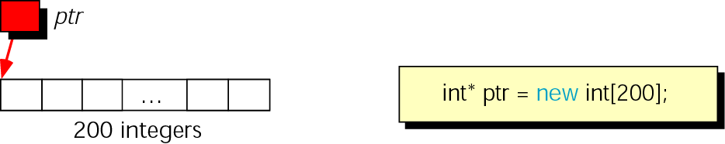
Memory allocation for an array

Slide 32
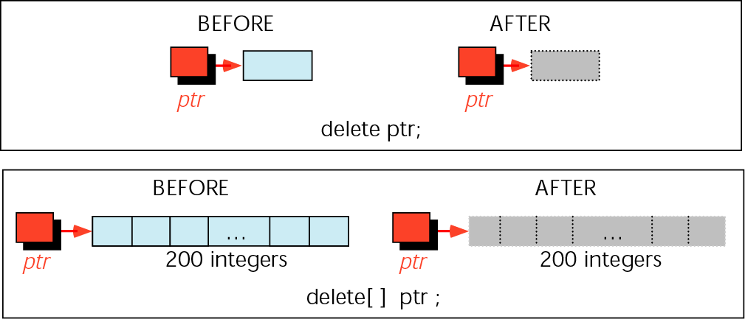
Freeing memory

Slide 33
Note:
Memory allocated by new must be released with delete, and memory allocated by new[…] must be released
with delete[ ].

Slide 34
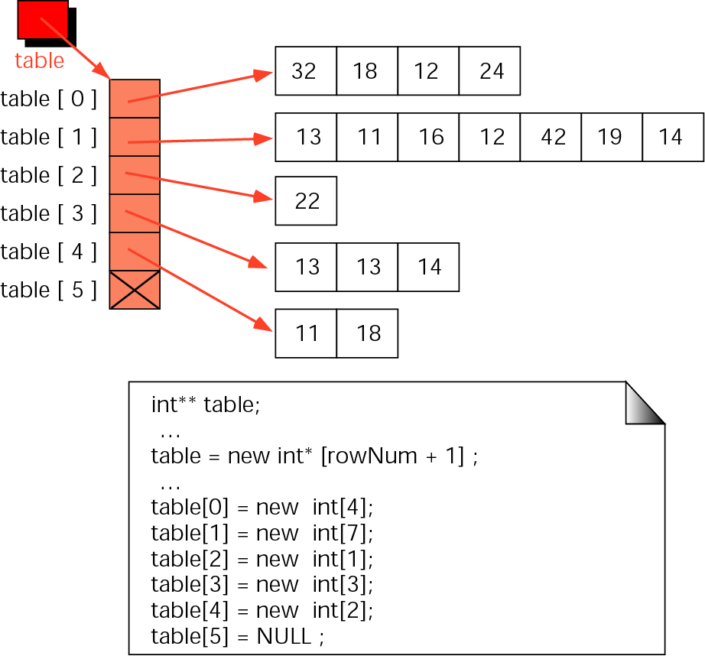
Array of pointers:
A ragged array

Slide 35
Dynamic vs. static memory allocation
 | Array | Dynamic Memory Allocation using Pointer
Declaration | int arrayVar[50]; | int* ptrVar;
Memory Allocation | Not required (automatically at program execution) | ptrVar = new int[50];
Memory Release | Impossible (memory reserved until termination) | delete ptrVar;
Too much data case | Impossible to increase memory size | Easy (allocate more memory)
Too small data case | Impossible to decrease Memory size | Easy (release and maintain small memory)
Pros | Easy to programming using just an INDEX | Optimized memory usage
Cons | Fixed memory space (Big program), Weak for unexpected memory request | Complex to manage pointers (side effect expected)

